Slide 1
Unit-3 Object Oriented Analysis
OO Analysis Overview
Architectural Analysis
Identify Entity – Domain Modeling
General Principles in Assigning Responsibilities
Analysis Class and Use Case Realization

Slide 2
OO Analysis Overview

Slide 3
4.1 OO Analysis Overview
Understanding Analysis
Analysis Versus Design
Object Oriented Analysis
Three ways to do Object Oriented Analysis

Slide 4
Understanding Analysis
In software engineering, analysis is the process of converting the user requirements to system specification
  system means the software to be developed.
System specification, also known as the logic structure, is the developer’s view of the system.
Function-oriented analysis – concentrating on the decomposition of complex functions to simply ones.
Object-oriented analysis – identifying objects and the relationship between objects.

Slide 5
Understanding Analysis
The goal in Analysis is to understand the problem
  and to begin to develop a visual model of what you are trying to build, independent of implementation and technology concerns.
Analysis focuses on translating the functional requirements into software concepts.
  The idea is to get a rough cut at the objects that comprise our system, but focusing on behavior (and therefore encapsulation).
  We then move very quickly, nearly seamlessly into “design” and the other concerns.

Slide 6
Analysis Versus Design
Analysis
  Focus on understanding the problem
  Idealized design
  Behavior
  System structure
  Functional requirements
  A small model
Design
  Focus on understanding the solution
  Operations and Attributes
  Performance
  Close to real code
  Object lifecycles
  Non-functional requirements
  A large model
Notes:
An instructor once said: “Analysis Vs. Design is important because of the mind-set. If you tried to manage all of the analysis and design issues in one go, your brain would explode on all but the most trivial developments. It’s just too much to take in, comprehend, and model in one go. So I mentally switch “OK, analysis - problem domain - don’t care about memory, persistence, databases, language, etc”. “Right now it’s design and I do care about all those things - but now I can stop thinking (too a degree) about trying to understand the business domain.” It’s about managing the 7+/-2 things I can think about in one go. It also separates out the skills (a bit).”
Another instructor once said: “analysis is the study of and eventual comprehension of “some thing” [the problem space]. But to understand it, we must invent some entities to hold onto the thing that we have just grasped - this inventive process is design. That is, human cognitive thinking is actually interwoven analysis/design and any attempt to separate them is really only an idealization. Therefore, if I try to apply two separate “steps” in the production of, say, a class diagram [and call those steps A and then D], I will introduce ambiguity into my process because cognitive process forces one to “produce a solution” in order to “understand a problem” - that D is necessary to have any results from A.”
Think of analysis as an idealized design step - where we ignore several complicating issues. This can turn into a religious debate.

Slide 7
Object Oriented Analysis
Identifying objects:
  Using concepts, CRC cards, stereotypes, etc.
Organising the objects:
  classifying the objects identified, so similar objects can later be defined in the same class.
Identifying relationships between objects:
  this helps to determine inputs and outputs of an object.
Defining operations of the objects:
  the way of processing data within an object.
Defining objects internally:
  information held within the objects.

Slide 8
Three ways to do Object Oriented Analysis
Conceptual model (Larman)
  Produce a “light” class diagram.
CRC cards (Beck, Cunningham)
  Index cards and role playing.
Analysis model with stereotypes (Jacobson)
  Boundaries, entities, control.

Slide 9
Architectural Analysis

Slide 10
4.2 Architectural Analysis
Architectural Analysis
Identification and Analysis of Architectural Factors
Summary of Themes in Architectural Analysis
Notes:
The following page numbers will help the instructor find the answers to the review questions:
Question 1: pp. 3-4
Question 2: p. 4
Question 3: p. 10
Question 4: p. 6
Question 5: pp. 8-9

Slide 11
Architectural Analysis
Architectural analysis is concerned with the identification and resolution of the system's non-functional (for example, quality) requirements, in the context of the functional requirements
In the UP, the term encompasses both architectural investigation (identification) and architectural design (resolution)
Notes:
The following page numbers will help the instructor find the answers to the review questions:
Question 1: pp. 3-4
Question 2: p. 4
Question 3: p. 10
Question 4: p. 6
Question 5: pp. 8-9

Slide 12
Architectural Analysis - Purpose
To define a candidate architecture for the system, based on experience gained from similar systems or in similar problem domains.
To define the architectural patterns, key mechanisms and modeling conventions for the system.
To define the reuse strategy
To provide input to the planning process

Slide 13
Design Model Overview
Requirement Model
Design Model
Use case
Use case realization
Layered Architecture
Use case report
<<layer>>
Special Application
<<layer>>
General Application
Glossary
<<layer>>
General Services
<<layer>>
System Services
Supplementary Specification
Architecture Mechanism

Slide 14
Common Steps in Architectural Analysis
Identify and analyze the non-functional requirements that have an impacton the architecture.
  Functional requirements are also relevant (especially in terms of variability or change), but the non-functional are given thorough attention.
  In general, all these may be called architectural factors (also known as the architectural drivers)
For those requirements with a significant architectural impact, analyze alternatives and create solutions that resolve the impact.
  These are architectural decisions.
Notes:
The following page numbers will help the instructor find the answers to the review questions:
Question 1: pp. 3-4
Question 2: p. 4
Question 3: p. 10
Question 4: p. 6
Question 5: pp. 8-9

Slide 15
Identification and Analysis of Architectural Factors
Architectural Factors
Quality Scenarios
Factor Table
Factors and UP Artifacts
Notes:
The following page numbers will help the instructor find the answers to the review questions:
Question 1: pp. 3-4
Question 2: p. 4
Question 3: p. 10
Question 4: p. 6
Question 5: pp. 8-9

Slide 16
Quality Scenarios
When defining quality requirements during architectural factor analysis, quality scenarios are recommended,
  as they define measurable (or at least observable) responses, and thus can be verified.
  It is not much use to vaguely state "the system will be easy to modify" without some measure of what that means.
  Quantifying some things, such as performance goals and mean time between failure, are well known practices, but quality scenarios extend this idea and encourages recording all (or at least, most) factors as measurable statements.
Quality scenarios are short statements of the form <stimulus> <measurable response>; for example:
  When the completed sale is sent to the remote tax calculator to add the taxes, the result is returned within 2 seconds "most" of the time, measured in a production environment under "average" load conditions.
  When a bug report arrives from a NextGen beta test volunteer, reply with a phone call within 1 working day.
Notes:
The following page numbers will help the instructor find the answers to the review questions:
Question 1: pp. 3-4
Question 2: p. 4
Question 3: p. 10
Question 4: p. 6
Question 5: pp. 8-9

Slide 17
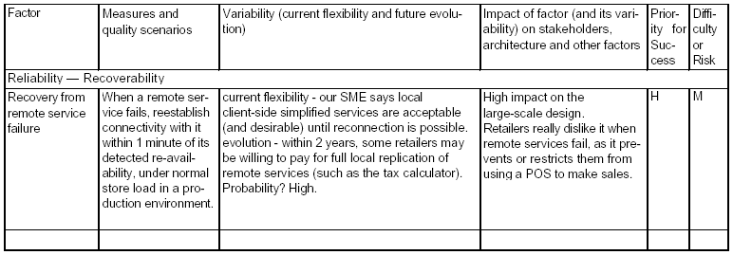
Factor Table
Most architectural methods advocate creating a table or tree with variations of the following information.
The following style shown in Table is called a factor table,
  which in the UP is part of the Supplementary Specification
Notes:
The following page numbers will help the instructor find the answers to the review questions:
Question 1: pp. 3-4
Question 2: p. 4
Question 3: p. 10
Question 4: p. 6
Question 5: pp. 8-9

Slide 18
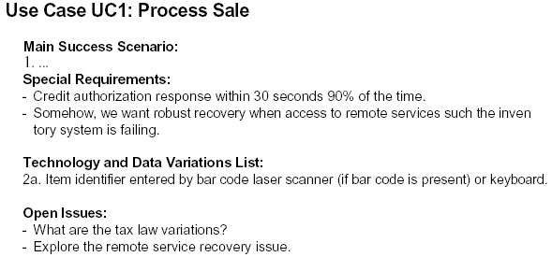
Factors and UP Artifacts
The central functional requirements repository in the UP are the use cases, and they, along with the Vision and Supplementary Specification, are an important source of inspiration when creating a factor table.
In the use cases, the Special Requirements,Technology Variations, and Open Issues should be reviewed, and their implied or explicit architectural factors consolidated in the Supplementary Specification.
Notes:
The following page numbers will help the instructor find the answers to the review questions:
Question 1: pp. 3-4
Question 2: p. 4
Question 3: p. 10
Question 4: p. 6
Question 5: pp. 8-9

Slide 19
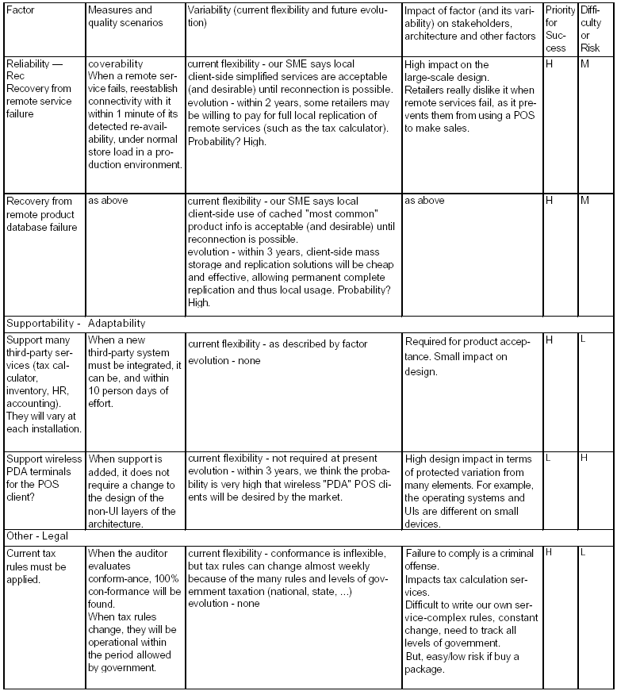
Example: Partial NextGen POS Architectural Factor Table
Notes:
The following page numbers will help the instructor find the answers to the review questions:
Question 1: pp. 3-4
Question 2: p. 4
Question 3: p. 10
Question 4: p. 6
Question 5: pp. 8-9

Slide 20
Summary of Themes in Architectural Analysis
"architectural" concerns are especially related to nonfunctional requirements,
  and include an awareness of the business or market context of the application.
  At the same time, the functional requirements (for example, processing sales) cannot be ignored; they provide the context within which these concerns must be resolved.
  Further,identification of their variability is architecturally significant.
architectural concerns involve system-level,large-scale, and broad problems whose resolution usually involves large-scale or fundamental design decisions
  for example, the choice of—or even use of—an application server.
interdependencies and trade-offs.
  For example, improved security may affect performance or usability, and most choices affect cost.
the generation and evaluation of alternative solutions
Notes:
The following page numbers will help the instructor find the answers to the review questions:
Question 1: pp. 3-4
Question 2: p. 4
Question 3: p. 10
Question 4: p. 6
Question 5: pp. 8-9

Slide 21
Architectural Information in the UP Artifacts
The architectural factors (for example, in a factor table) are recorded in the Supplementary Specification.
Notes:
The following page numbers will help the instructor find the answers to the review questions:
Question 1: pp. 3-4
Question 2: p. 4
Question 3: p. 10
Question 4: p. 6
Question 5: pp. 8-9

Slide 22
Identify Entity – Domain Modeling

Slide 23
4.3 Identify Entity – Domain Modeling
Visualizing Concepts
Adding Associations
Adding Attributes
Modeling Generalization
Refining the Domain Model

Slide 24
VISUALIZING CONCEPTS
Domain Models
Conceptual Class Identification
Domain Modeling Guidelines
Resolving Similar Conceptual Classes
Modeling the Unreal world
Specification Conceptual Classes
UML Notation v.s. Methodology
Lowering the Representational Gap
Domain Models within the UP

Slide 25
Domain Models
A domain model is a representation of real-world conceptual classes
  not a representation of software components.
  not a set of diagrams describing software classes,
  not software objects with responsibilities.
A domain model is a visual representation of conceptual classes or real-world objects in a domain of interest [MO95, Fowler96]
  They have also been called conceptual models, domain object models, and analysis object models.
The UP defines a Domain Model as one of the artifacts that may be created in the Business Modeling discipline.

Slide 26
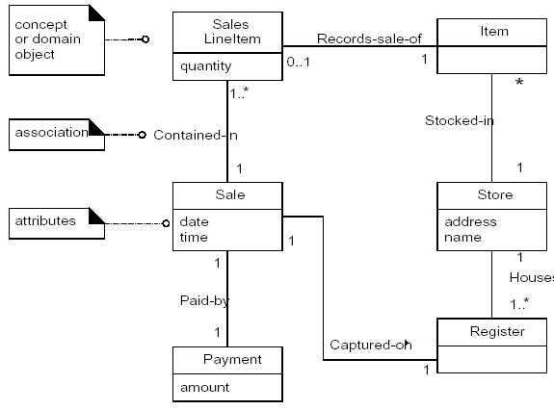
Domain Models
Using UML notation, a domain model is illustrated with a set of class diagrams in which no operations are defined. It may show:
  domain objects or conceptual classes
  associations between conceptual classes
  attributes of conceptual classes

Slide 27
Domain Models
The domain model illustrates conceptual classes or vocabulary in the domain.
Domain Models are not models of software components. The following elements are not suitable in a domain model:
  Software artifacts, such as a window or a database, unless the domain being modeled is of software concepts, such as a model of graphical user interfaces.
  Responsibilities or methods.

Slide 28


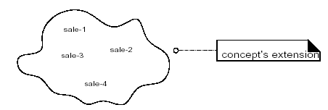
Domain Models
The domain model illustrates conceptual classes or vocabulary in the domain.
Informally, a conceptual class is an idea, thing, or object.
More formally, a conceptual class may be considered in terms of its symbol, intension, and extension[MO95].
  Symbol—words or images representing a conceptual class.
  Intension—the definition of a conceptual class.
  Extension—the set of examples to which the conceptual class applies.

Slide 29
Domain Models
Software problems can be complex;
  Decomposition (divide-and-conquer) is a common strategy to deal with this complexity by division of the problem space into comprehensible units.
  In structured analysis, the dimension of decomposition is by processes or functions.
  However, in object-oriented analysis, the dimension of decomposition is fundamentally by things or entities in the domain.
A central distinction between object-oriented and structured analysis is: division by conceptual classes (objects) rather than division by functions.
A primary analysis task is to identify different concepts in the problem domain and document the results in a domain model

Slide 30
Conceptual Class Identification
A useful guideline in identifying conceptual classes:
  It is better to overspecify a domain model with lots of fine-grained conceptual classes than to underspecify it.
Strategies to Identify Conceptual Classes.
  Use a conceptual class category list.
  Finding conceptual classes with Noun Phrase Identification
Another excellent technique for domain modeling is the use of analysis patterns, which are existing partial domain models created by experts,
  using published resources such as Analysis Patterns [Fowler96] and Data Model Patterns[Hay96].

Slide 31
Conceptual Classes
A conceptual class is a real-world concept or thing; a conceptual or essential perspective.
At the noun filtering stage we are looking for conceptual classes. As we move through the design process we will start to design software classes that represent an implementation perspective of a software component but we will not get into language specific classees.
A conceptual class is not an implementation class, such as a class that can be implemented in an OO language such as Java or C++. That comes much later.

Slide 32
Conceptual Class Category | Examples
Physical or tangible objects | Register, Airplane
Specifications, deigns or descriptions of things | ProductSpecification, FlightDescription
Places | Store, Airport
Transactions | Sale, Payment, Reservation
Transaction line items | SalesLineItem
Roles of people | Cashier, Pilot
Containers of other things | Store, Bin, Airplane
Things in a container | Item, Passenger
Other computer or electro-mechanical systems external to the system | CreditPaymentAuthorizationSystem AirTrafficControl
Organizations | SalesDepartment, ObjectAirline
Events | Sale, Payment, Meeting, Flight, Crash, Landing
Rules and policies | RefundPolicy CancellationPolicy
Catalogs | ProductCatalog, PartsCatalog
Records of finance, work, contracts, legal matters | Receipt, Ledger, EmploymentContract, MaintenanceLog
Financial instruments and services | LineOfCredit, Stock
Manuals, documents, reference papers, books | DailyPriceChangeList , RepairManual

Slide 33
Domain Modeling Guidelines
How to Make a Domain Model
  1. List the candidate conceptual classes using the Conceptual Class Category List and noun phrase identification techniques related to the current requirements under consideration.
  2. Draw them in a domain model.
  3. Add the associations necessary to record relationships for which there is a need to preserve some memory.
  4. Add the attributes necessary to fulfill the information requirements.
On Naming and Modeling Things
  use the vocabulary of the domain when naming conceptual classes and attributes.
    For example, if developing a model for a library, name the customer a "Borrower" or "Patron"—the terms used by the library staff.
  a domain model may exclude conceptual classes in the problem domain not pertinent to the requirements.
    For example, we may exclude Pen and PaperBag from our domain model (for the current set of requirements) since they do not have any obvious noteworthy role.
  the domain model should exclude things not in the problem domain under consideration.

Slide 34
Domain Modeling Guidelines
A Common Mistake in Identifying Conceptual Classes
  Perhaps the most common mistake when creating a domain model is to represent something as an attribute when it should have been a concept.
  A rule of thumb to help prevent this mistake is:
    If we do not think of some conceptual class X as a number or text in the real world, X is probably a conceptual class, not an attribute.
As an example, should store be an attribute of Sale, or a separate conceptual class Store?
  In the real world, a store is not considered a number or text - the term suggests a legal entity, an organization, and something occupies space. Therefore, Store should be a concept.
As another example, consider the domain of airline reservations. Should destination be an attribute of Flight, or a separate conceptual class Airport?
  In the real world, a destination airport is not considered a number or text—it is a massive thing that occupies space. Therefore, Airport should be a concept.

Slide 35
Resolving Similar Conceptual Classes
As a example, in the domain model, should the symbol Register be used instead of POST?
  POST" is a term familiar in the territory, so it is a useful symbol from the point of view of familiarity and communication.
  By the goal of creating models that represent abstractions and are implementation independent, Register is appealing and useful.
As a rule of thumb, a domain model is not absolutely correct or wrong, but more or less useful; it is a tool of communication.

Slide 36
Modeling the Unreal world
Some software systems are for domains that find very little analogy in natural or business domains;
  software for telecommunications is an example.
It is still possible to create a domain model in these domains, but it requires a high degree of abstraction and stepping back from familiar designs.
For example, here are some candidate conceptual classes related to a telecommunication switch:
  Message, Connection, Port, Dialog, Route, Protocol.

Slide 37
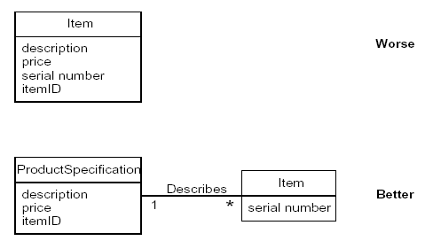
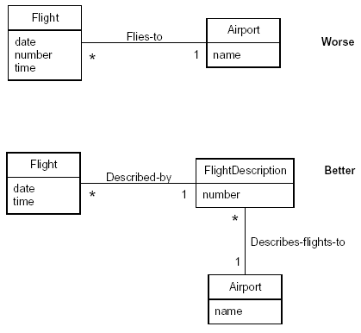
Specification or Description Conceptual Classes
Specifications or descriptions about other things.

Slide 38
Specification or Description Conceptual Classes
Add a specification or description conceptual class (for example, ProductSpecification) when:
  There needs to be a description about an item or service, independent of the current existence of any examples of those items or services.
  Deleting instances of things they describe (for example, Item) results in a loss of information that needs to be maintained, due to the incorrect association of information with the deleted thing.
  It reduces redundant or duplicated information.

Slide 39
UML Notation v.s. Methodology
The UML simply describes raw diagram types, such as class diagrams and sequence diagrams. It does not superimpose a method or modeling perspective on these.
Rather, a process (such as the UP) applies raw UML in the context of methodologist-defined models.
Three perspectives and types of models:
  Conceptual perspective
    the diagrams are interpreted as describing things in the real world or domain of interest.
  Specification perspective
    the diagrams are interpreted as describing software abstractions or
    components with specifications and interfaces, but no commitment to a particular implementation (for example, not specifically a class in C# or Java).
  Implementation perspective
    the diagrams are interpreted as describing software implementations in a particular technology and language (such as Java).

Slide 40
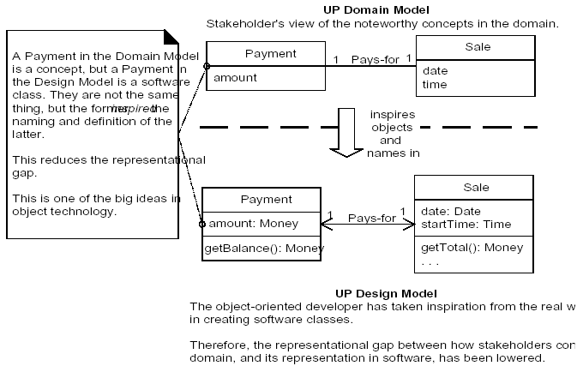
Lowering the Representational Gap
The Domain Model provides a visual dictionary of the domain vocabulary and concepts from which to draw inspiration for the naming of some things in the software design.
In object design and programming it is common to create software classes whose names and information is inspired from the real world domain.

Slide 41
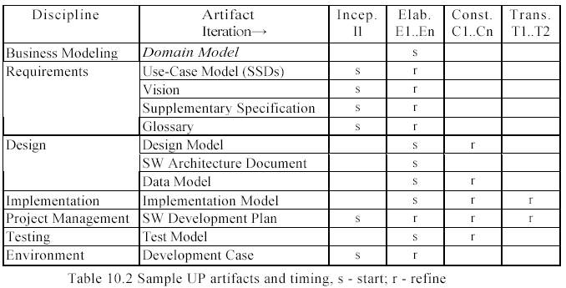
Domain Models within the UP
Domain models are not strongly motivated in inception,
  since inception's purpose is not to do a serious investigation, but rather to decide if the project is worth deeper investigation in an elaboration phase.
The Domain Model is primarily created during elaboration iterations,
  when the need is highest to understand the noteworthy concepts and map some to software classes during design work.

Slide 42
Domain Models within the UP
The UP Domain Model is an official variation of the less common UP Business Object Model (BOM).
[The UP BOM] serves as an abstraction of how business workers and business entities need to be related and how they need to collaborate in order to perform the business. [RUP]
  The BOM is represented with several different diagrams (class, activity, and sequence) that illustrate how the entire enterprise runs (or should run).
  It is most useful if doing enterprise-wide business process engineering,
  but that is a less common activity than creating a single software application.
Consequently, the UP defines the Domain Model as the more commonly created subset artifact or specialization of the BOM.

Slide 43
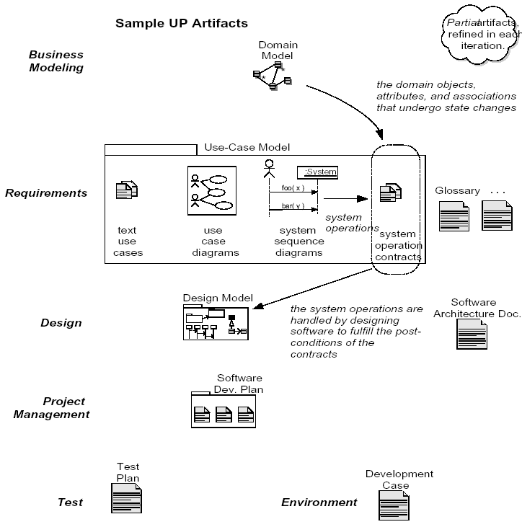
Domain Models within the UP
Artifact influence emphasizing the Domain Model

Slide 44
Adding Association
Associations
The UML Association Notation
Finding Associations
Association Guidelines
Roles
How Detailed Should Associations Be?
Naming Associations
Multiple Associations Between Two Types
Associations and Implementation
Example

Slide 45
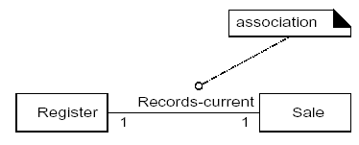
Associations
An association is a relationship between types (or more specifically, instances of those types) that indicates some meaningful and interesting connection
In the UML associations are defined as "the semantic relationship between two or more classifiers that involve connections among their instances.“
Criteria for Useful Associations
  Associations for which knowledge of the relationship needs to be preserved for some duration ("need-to-know" associations).
  Associations derived from the Common Associations List.

Slide 46
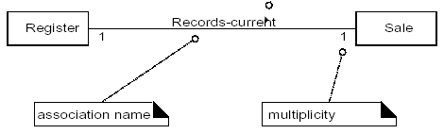
The UML Association Notation
An association is represented as a line between classes with an association name.
  The association is inherently bidirectional, meaning that from instances of either class, logical traversal to the other is possible.
  This traversal is purely abstract; it is not a statement about connections between software entities.
  The ends of an association may contain a multiplicity expression indicating the numerical relationship between instances of the classes.
  An optional "reading direction arrow" indicates the direction to read the association name; it does not indicate direction of visibility or navigation.

Slide 47
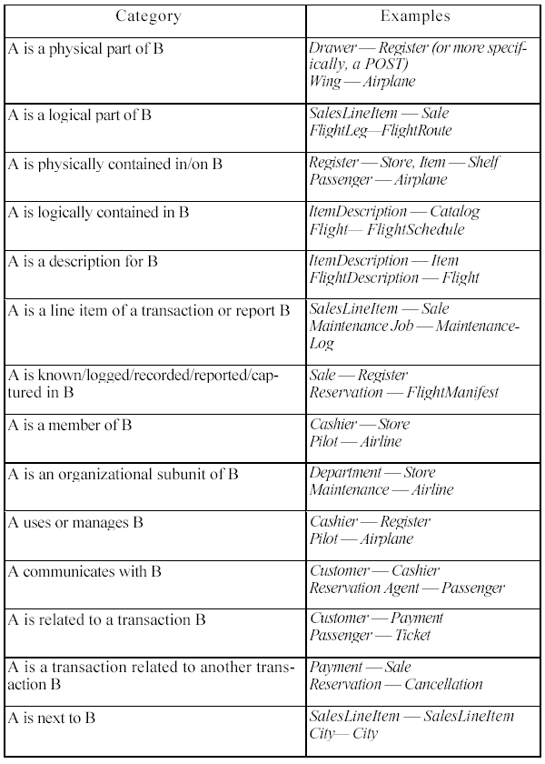
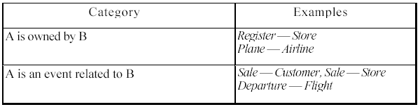
Finding Associations
Start the addition of associations by using the Common Associations List
  It contains common categories that are usually worth considering.
Here are some high-priority association categories that are invariably useful to include in a domain model:
  A is a physical or logical part of B.
  A is physically or logically contained in/on B.
  A is recorded in B.

Slide 48
Association Guidelines
Focus on those associations for which knowledge of the relationship needs to be preserved for some duration ("need-to-know" associations).
It is more important to identify conceptual classes than to identify associations.
Too many associations tend to confuse a domain model rather than illuminate it. Their discovery can be time-consuming, with marginal benefit.
Avoid showing redundant or derivable associations.

Slide 49
Roles
Each end of an association is called a role. Roles may optionally have:
  name
  multiplicity expression
  navigability

Slide 50
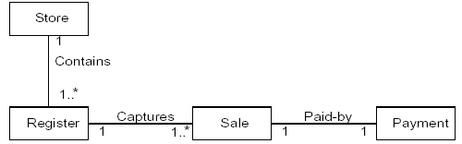
Naming Associations
Name an association based on a TypeName-VerbPhrase-TypeName format where the verb phrase creates a sequence that is readable and meaningful in the model context.

Slide 51

Multiple Associations Between Two Types
Two types may have multiple associations between them;
  this is not uncommon.

Slide 52
Associations and Implementation
During domain modeling, an association is not a statement about data flows, instance variables, or object connections in a software solution;
it is a statement that a relationship is meaningful in a purely conceptual sense—in the real world.

Slide 53
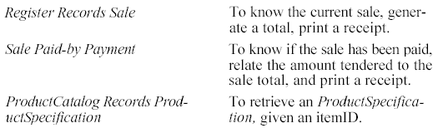
Example
The following sample of associations is justified in terms of a need-to-know.
  It is based on the use cases currently under consideration.

Slide 54
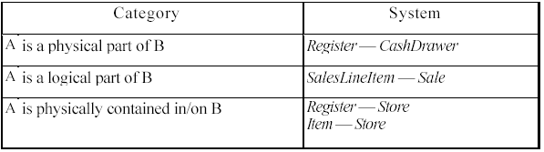
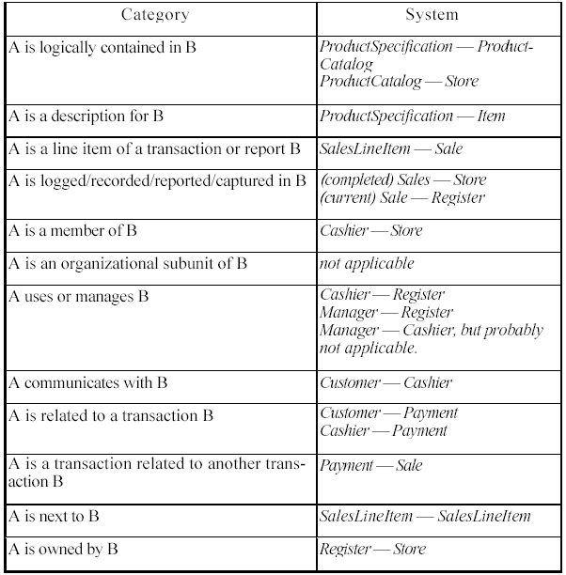
Example-Applying the Category of Associations Checklist

Slide 55
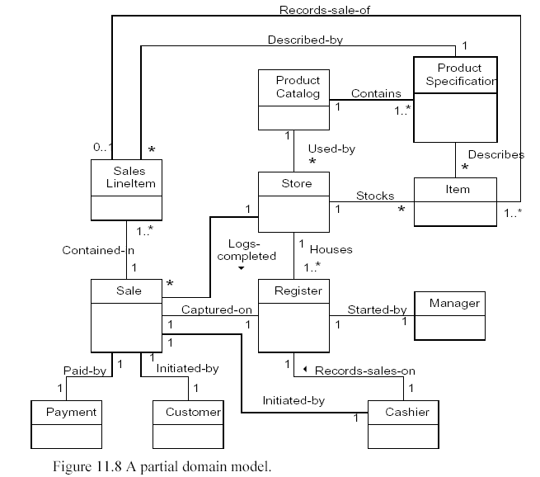
Example

Slide 56
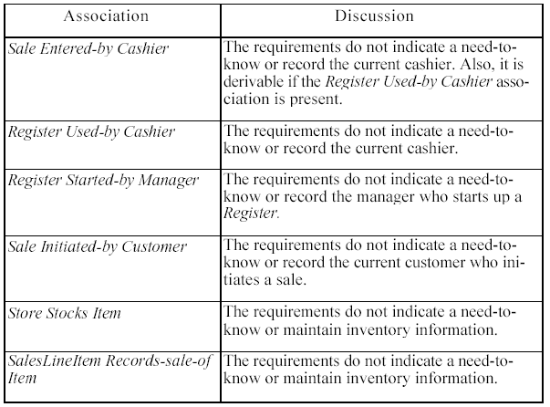
Example

Slide 57
Adding Attributes
Attributes VS. Associations
Non-primitive Data Type Classes
No Attributes as Foreign Keys
Modeling Attribute Quantities and Units

Slide 58
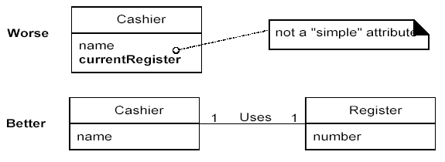
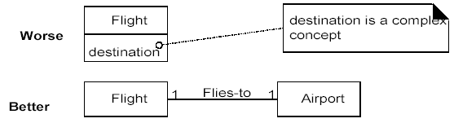
Attributes VS. Associations
The attributes in a domain model should preferably be simple attributes or data types.

Slide 59
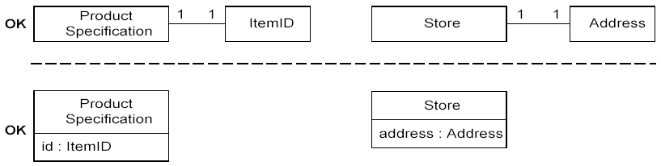
Non-primitive Data Type Classes
If the attribute class is a data type, it may be shown in the attribute box.

Slide 60
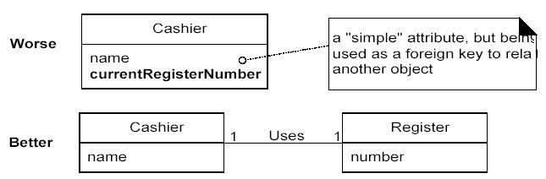
Design Creep: No Attributes as Foreign Keys
Attributes should not be used to relate conceptual classes in the domain model.
The most common violation of this principle is to add a kind of foreign key attribute, as is typically done in relational database designs, in order to associate two types.

Slide 61
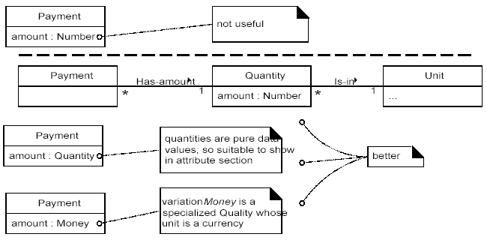
Modeling Attribute Quantities and Units
Most numeric quantities should not be represented as plain numbers.

Slide 62
Modeling Generalization
New Concepts for the Domain Model
Generalization
Defining Conceptual Superclasses and Subclasses
Abstract Conceptual Classes
Modeling Changing States

Slide 63
Category Concepts List
Category | Examples
physical or tangible objects | CreditCard, Check
Transactions | CashPayment, CreditPayment, CheckPayment
other computer or electro-mechanical systems external to our system | CreditAuthorizationService, CheckAuthorizationService
abstract noun concepts
organizations | CreditAuthorizationService, CheckAuthorizationService
records of finance, work, contracts, legal matters | AccountsReceivable

Slide 64
Noun Phrase Identification from the Use Cases
Use Case UC1: Process Sale
7b. Paying by credit:
1. Customer enters their credit account information.
2. System sends payment authorization request to an external Payment Authorization Service System, and requests payment approval.
2a. System detects failure to collaborate with external system:
        1. System signals error to Cashier.
        2. Cashier asks Customer for alternate payment.
3. System receives payment approval and signals approval to Cashier.
3a. System receives payment denial:
  1. System signals denial to Cashier.
  2. Cashier asks Customer for alternate payment.
4. System records the credit payment, which includes the payment approval.
5. System presents credit payment signature input mechanism.
6. Cashier asks Customer for a credit payment signature. Customer enters signature.

Slide 65
Noun Phrase Identification from the Use Cases
Use Case UC1: Process Sale
7c. Paying by check:
1. The Customer writes a check, and gives it and their driver's license to the Cashier.
2. Cashier writes the driver's license number on the check, enters it, and requests check payment authorization.
3. Generates a check payment request and sends it to an external Check Authorization Service.
4. Receives a check payment approval and signals approval to Cashier.
5. System records the check payment, which includes the payment approval.

Slide 66
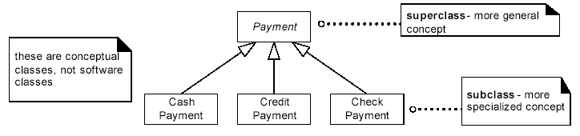
generalization-specialization class hierarchy
The concepts CashPayment, CreditPayment, and Check Payment are all very similar.

Slide 67
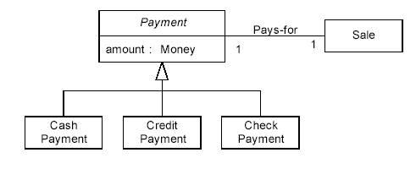
Conceptual Subclass Definition Conformance
All Payment subclasses must conform to having an amount and paying for a Sale.
100% Rule
  The subclass must conform to 100% of the superclass's:
    attributes
    associations

Slide 68
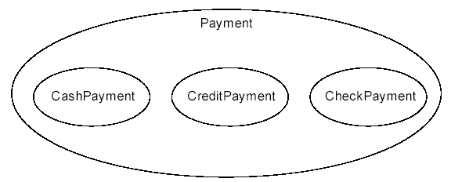
Conceptual Subclass Set Conformance
CreditPayment should be a member of the set of Payments.
CheckPayment is a kind of Payment.
Is-a Rule
  All the members of a subclass set must be members of their superclass set.

Slide 69
When to Define a Conceptual Subclass?
A potential subclass should conform to the:
  100% Rule (definition conformance)
  Is-a Rule (set membership conformance)

Slide 70
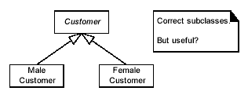
What Is a Correct Conceptual Subclass?
Create a conceptual subclass of a superclass when:
  The subclass has additional attributes of interest.
  The subclass has additional associations of interest.
  The subclass concept is operated on, handled, reacted to, or manipulated differently than the superclass or other subclasses, in ways that are of interest.
  The subclass concept represents an animate thing (for example, animal,robot) that behaves differently than the superclass or other subclasses,in ways that are of interest.

Slide 71
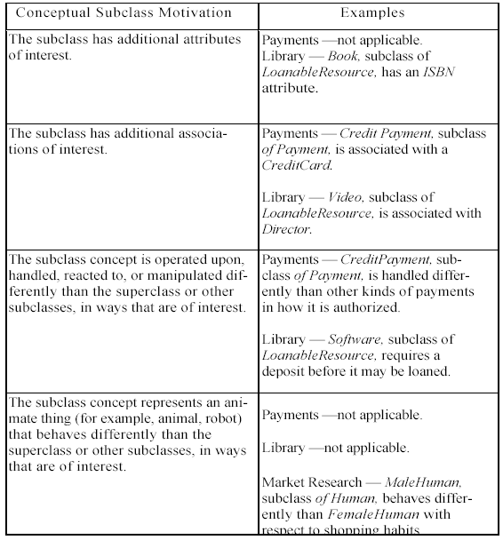
Example subclass partitions

Slide 72
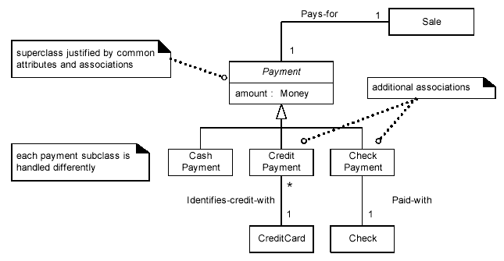
NextGen POS Conceptual Class Hierarchies

Slide 73
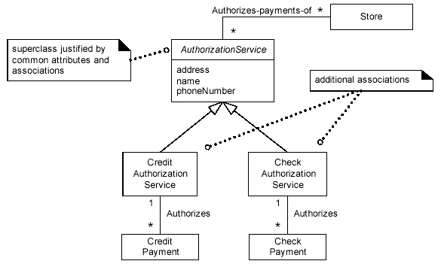
NextGen POS Conceptual Class Hierarchies

Slide 74
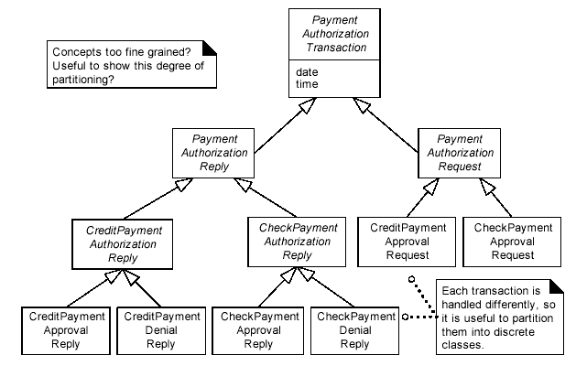
Concepts too fine grained?

Slide 75
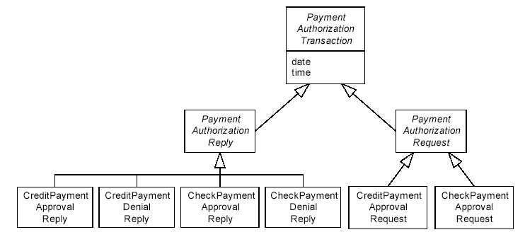
Concepts too fine grained?

Slide 76
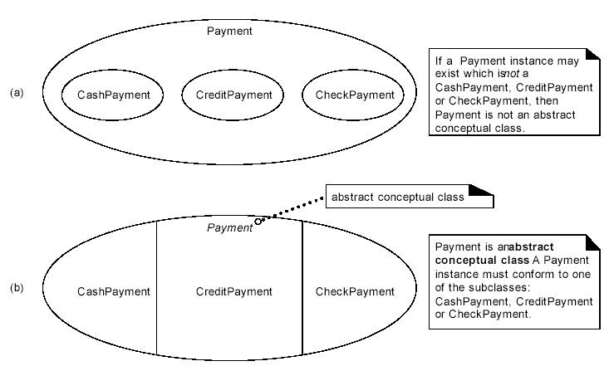
Abstract Conceptual Classes

Slide 77
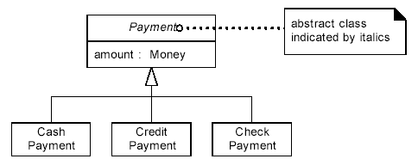
Abstract Class Notation in the UML

Slide 78
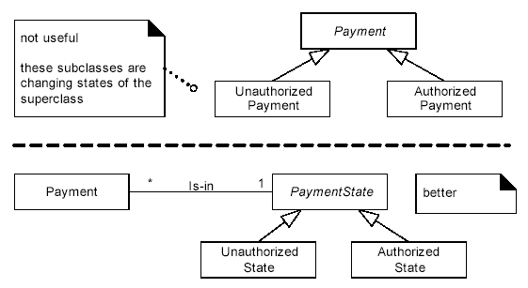
Modeling Changing States
Do not model the states of a concept X as subclasses of X. Rather, either:
  Define a state hierarchy and associate the states with X, or
  Ignore showing the states of a concept in the domain model; show the states in state diagrams instead..

Slide 79
Refining the domain model
Association Classes
Aggregation and Composition
Roles as Concepts vs. Roles in Associations
Qualified Associations
Reflexive Associations
Using Packages to Organize the Domain Model

Slide 80
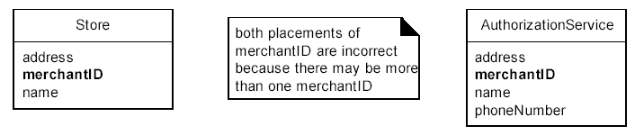
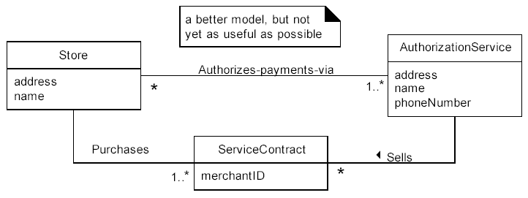
Association Classes

Slide 81
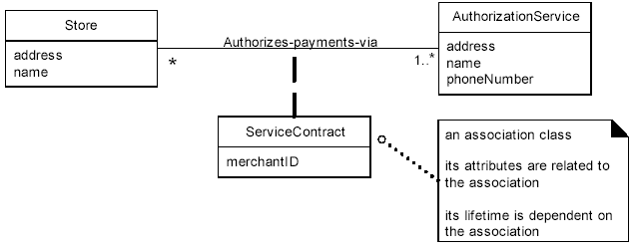
Association Classes
Clues that an association class might be useful in a domain model:
  An attribute is related to an association.
  Instances of the association class have a life-time dependency on the association.
  There is a many-to-many association between two concepts, and information associated with the association itself...

Slide 82
Aggregation
A special form of association that models a whole-part relationship between an aggregate (the whole) and its parts
Whole
Part
Student
Schedule
Aggregation
Notes:
There are many examples of whole-part relationships: a Library contains Books, within a company Departments are made-up of Employees, a Computer is composed of a number of Devices. However, whether you model a relationship as an association or aggregation is really dependent on the domain being modeled. This is discussed in more detail on a later slide.
An aggregation is a stronger form of relationship where the relationship is between a whole and its parts. The aggregate has an aggregation association to the its constituent parts. A hollow diamond is attached to the end of an association path on the side of the aggregate (the whole) to indicate aggregation.
Since aggregation is a special form of association, the use of multiplicity, roles, navigation, etc. is the same as for association.
Sometimes, a class may be aggregated with itself. This does not mean that an instance of that class is composed of itself (this would be silly), it means that one instance if the class is an aggregate composed of other instances of the same class.
Some situations where aggregation may be appropriate:
An object is physically composed of other objects (e.g. car being physically composed of an engine and four wheels).
An object is a logical collection of other objects (e.g., a family is a collection of parents and children).
An object physically contains other objects (e.g., an airplane physically contains a pilot).
In the above example, the relationship from Student to Schedule is modeled as an aggregation because a Schedule is inherently tied to a particular Student. A Schedule outside of the context of a Student makes no sense in a Course Registration System.

Slide 83
Composition
A form of aggregation with strong ownership and coincident lifetimes
  The parts cannot survive the whole/aggregate
Whole
Part
Student
Schedule
Composition
Notes:
Note: Compositional aggregation can be shown by nesting one class within another. However, Rose does not directly support the drawing of a class within a class.
Composition is not equivalent to containment by value, as some languages do not support containment by value (e.g., Java). By-value vs. by-reference is an implementation “thing”, whereas composition is a conceptual “thing” that can be realized in the implementation using by-value, or by-reference (if the distinction is supported). Note: In Rose, composition is modeled by specifying “by-value” for the containment property of a role of a relationship.
Composition is a form of aggregation with strong ownership and coincident lifetimes of the part with the aggregate. The whole “owns” the part and is responsible for the creation and destruction of the part. The part is removed when the whole is removed. The part may be removed (by the whole) before the whole is removed.
A solid filled diamond is attached to the end of an association path (on the “whole side”) to indicate composition.
In some cases, composition can be identified as early as analysis, but more often it is not until design that such decisions can be made confidently. That is why composition is introduced here rather than in Use-Case Analysis.

Slide 84
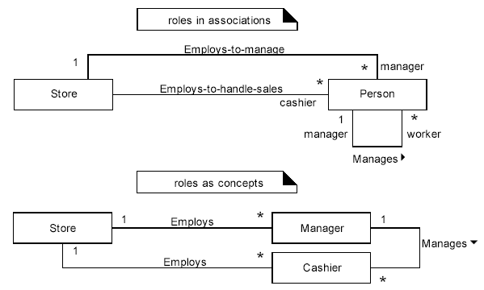
Roles as Concepts vs. Roles in Associations
In a domain model, a real-world role—especially a human role—may be modeled in a number of ways, such as a discrete concept (roles as concepts), or expressed as a role in an association (roles in associations).

Slide 85
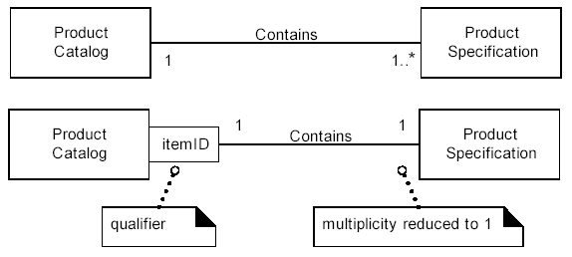
Qualified Associations
A qualifier may be used in an association; it distinguishes the set of objects at the far end of the association based on the qualifier value.
An association with a qualifier is a qualified association.

Slide 86
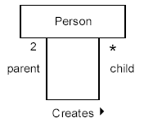
Reflexive Associations
A concept may have an association to itself; this is known as a reflexive association

Slide 87
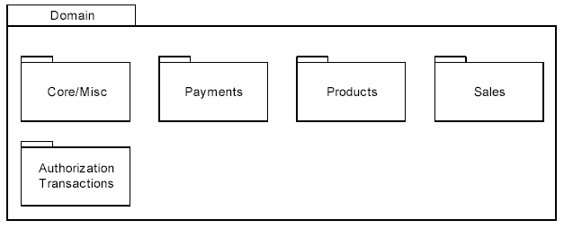
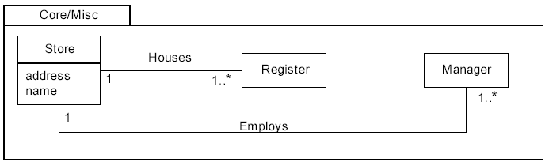
Using Packages to Organize the Domain Model

Slide 88
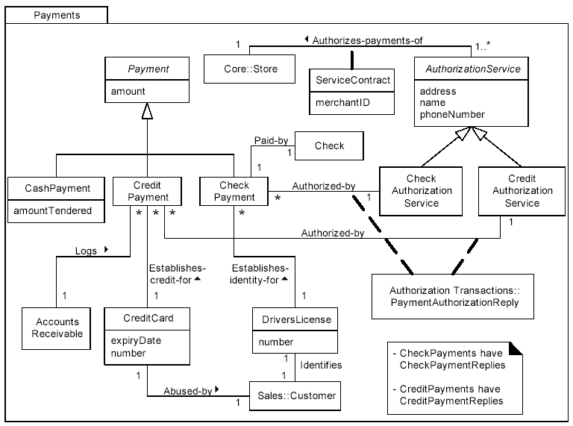
Using Packages to Organize the Domain Model

Slide 89
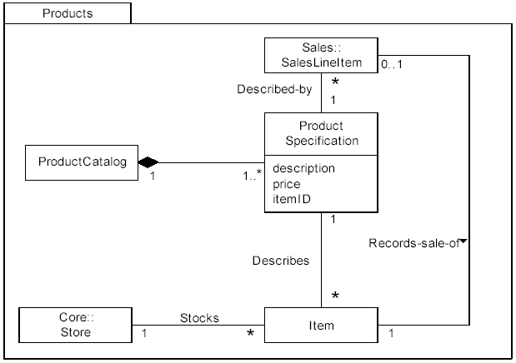
Using Packages to Organize the Domain Model

Slide 90
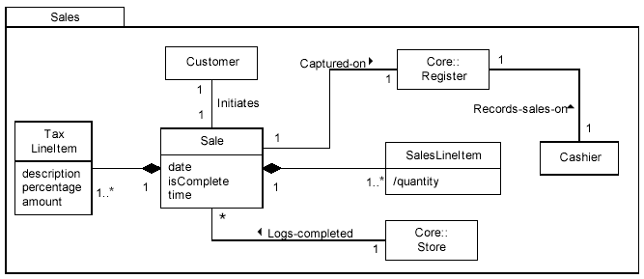
Using Packages to Organize the Domain Model

Slide 91
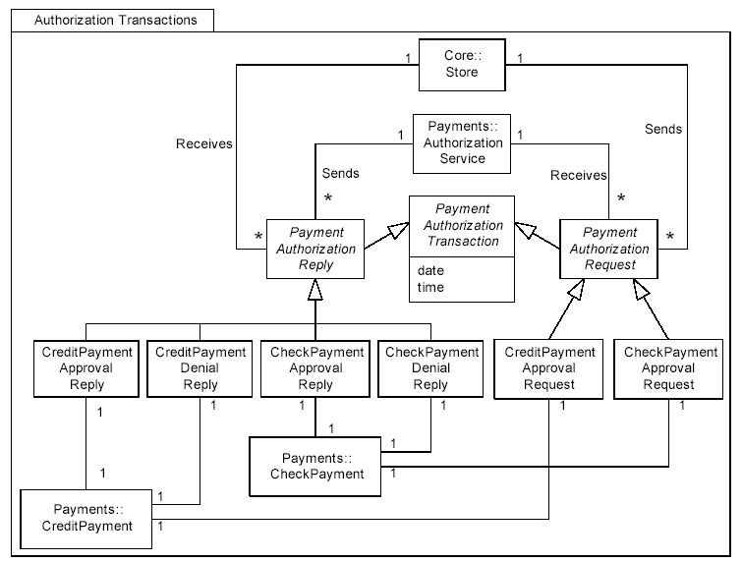
Using Packages to Organize the Domain Model

Slide 92
General Principles in Assigning
Responsibilities

Slide 93
4.4 General Principles in Assigning Responsibilities
Responsibilities
Responsibility-Driven Design
CRC Cards
GRASP
Notes:
The following page numbers will help the instructor find the answers to the review questions:
Question 1: pp. 3-4
Question 2: p. 4
Question 3: p. 10
Question 4: p. 6
Question 5: pp. 8-9

Slide 94
Responsibilities
The UML defines a responsibility as "a contract or obligation of a classifier"
A knowing or doing service or group of services provided by an element (such as a class or subsystem);
A responsibility embodies one or more of the purposes or obligations of an element.
A popular way of thinking about the design of software objects and also larger-scale components is in terms of responsibilities, roles, and collaborations.
Notes:
The following page numbers will help the instructor find the answers to the review questions:
Question 1: pp. 3-4
Question 2: p. 4
Question 3: p. 10
Question 4: p. 6
Question 5: pp. 8-9

Slide 95
Responsibilities
Doing responsibilities of an object include:
  doing something itself, such as creating an object or doing a calculation
  initiating action in other objects
  controlling and coordinating activities in other objects
Knowing responsibilities of an object include:
  knowing about private encapsulated data
  knowing about related objects
  knowing about things it can derive or calculate
For example
  "a Sale is responsible for creating SalesLineItems" (a doing),
  "a Sale is responsible for knowing its total" (a knowing).
Notes:
The following page numbers will help the instructor find the answers to the review questions:
Question 1: pp. 3-4
Question 2: p. 4
Question 3: p. 10
Question 4: p. 6
Question 5: pp. 8-9

Slide 96
Responsibility-Driven Design (RDD)
A general metaphor for thinking about OO software design
RDD leads to viewing an OO analysis & design as a community of collaborating responsible objects.
RDD also includes the idea of collaboration.
  Responsibilities are implemented by means of methods that either act alone or collaborate with other methods and objects.
In RDD, Responsibilities are related to the obligations or behavior of an object in terms of its role.
Notes:
The following page numbers will help the instructor find the answers to the review questions:
Question 1: pp. 3-4
Question 2: p. 4
Question 3: p. 10
Question 4: p. 6
Question 5: pp. 8-9

Slide 97
CRC cards
CRC stands for Class-Responsibility-Collaborator. They look like:
  one per class, which shows its responsibilities and with which other class(es) it must collaborate in order to fulfill each responsibility.
  Write a brief description of the class on the back of the card.
CRC cards are useful in detecting responsibilities of objects (developed by Kent Beck and Ward Cunningham).
Name
Responsibilities
Collaborators

Slide 98
CRC Cards - Example
In this example, class Foo must collaborate with (send messages to) classes X & Y in order to fulfill its responsibility to be able to “do something.”
Class Name
Foo
RESPONSIBILITIES
COLLABORATIONS
Do something
Classes X & Y
Notes:
In the Best Practices module, we discussed some characteristics common to successful projects. OO facilitates the following best practices:
Develop Iteratively
Model Visually
Use Component Architecture
Defining basic OO terms and concepts allows everyone in the class to start on a level playing field.

Slide 99
GRASP : General Principles in Assigning Responsibilities
Creator
Information Expert
Low Coupling
Controller
High Cohesion
Notes:
The following page numbers will help the instructor find the answers to the review questions:
Question 1: pp. 3-4
Question 2: p. 4
Question 3: p. 10
Question 4: p. 6
Question 5: pp. 8-9

Slide 100
GRASP - Creator
Problem:
  Who creates an A?
Solution
  Assign class B the responsibility to create an instance of class A if one of these is true (the more the better):
    B "contains" or compositely aggregates A.
    B records A.
    B closely uses A.
    B has the initializing data for A.
Notes:
The following page numbers will help the instructor find the answers to the review questions:
Question 1: pp. 3-4
Question 2: p. 4
Question 3: p. 10
Question 4: p. 6
Question 5: pp. 8-9

Slide 101
GRASP - Information Expert
Problem:
  What is a basic principle by which to assign responsibilities to objects?
Solution
  Assign a responsibility to the class that has the information needed to fulfill it.
Notes:
The following page numbers will help the instructor find the answers to the review questions:
Question 1: pp. 3-4
Question 2: p. 4
Question 3: p. 10
Question 4: p. 6
Question 5: pp. 8-9

Slide 102
GRASP - Low Coupling
Problem:
  How to reduce the impact of change?
Solution
  Assign responsibilities so that (unnecessary) coupling remains low.
  Use this principle to evaluate alternatives.
Notes:
The following page numbers will help the instructor find the answers to the review questions:
Question 1: pp. 3-4
Question 2: p. 4
Question 3: p. 10
Question 4: p. 6
Question 5: pp. 8-9

Slide 103
GRASP - Controller
Problem:
  What first object beyond the UI layer receives and coordinates ("controls") a system operation?
Solution
  Assign the responsibility to an object representing one of these choices:
    Represents the overall "system," a "root object," a device that the software is running within, or a major subsystem (these are all variations of a facade controller).
    Represents a use case scenario within which the system operation occurs (a use case or session controller)
Notes:
The following page numbers will help the instructor find the answers to the review questions:
Question 1: pp. 3-4
Question 2: p. 4
Question 3: p. 10
Question 4: p. 6
Question 5: pp. 8-9

Slide 104
GRASP - Low Coupling
Problem:
  How to keep objects focused, understandable, and manageable, and as a side effect, support Low Coupling?
Solution
  Assign responsibilities so that cohesion remains high.
  Use this to evaluate alternatives.
Notes:
The following page numbers will help the instructor find the answers to the review questions:
Question 1: pp. 3-4
Question 2: p. 4
Question 3: p. 10
Question 4: p. 6
Question 5: pp. 8-9

Slide 105
Analysis Class and Use Case
Realization

Slide 106
4.5 Analysis Class and Use Case Realization
What is an Analysis Class?
Use Case Realization
Notes:
The following page numbers will help the instructor find the answers to the review questions:
Question 1: pp. 3-4
Question 2: p. 4
Question 3: p. 10
Question 4: p. 6
Question 5: pp. 8-9

Slide 107
What is an Analysis Class?
Analysis classes represent an early conceptual model for ‘things in the system which have responsibilities and behavior’.
Analysis classes are used to capture a ‘first-draft’, rough-cut of the object model of the system.
Analysis classes handle primarily functional requirements.
They model objects from the problem domain.
Notes:
The following page numbers will help the instructor find the answers to the review questions:
Question 1: pp. 3-4
Question 2: p. 4
Question 3: p. 10
Question 4: p. 6
Question 5: pp. 8-9

Slide 108
What is an Analysis Class?
There are three aspects of the system that are likely to change:
  the boundary between the system and its actors,
  the information the system uses, and
  the control logic of the system.
behaviour
information
boundary
Notes:
The following page numbers will help the instructor find the answers to the review questions:
Question 1: pp. 3-4
Question 2: p. 4
Question 3: p. 10
Question 4: p. 6
Question 5: pp. 8-9

Slide 109
What is an Analysis Class?
In an effort to isolate the parts of the system that will change, different types of analysis classes are identified with a “canned” set of responsibilities:
  boundary,
  entity and
  control classes.
Control
entity
boundary
Notes:
The following page numbers will help the instructor find the answers to the review questions:
Question 1: pp. 3-4
Question 2: p. 4
Question 3: p. 10
Question 4: p. 6
Question 5: pp. 8-9

Slide 110
What is an Analysis Class?
<<boundary>>
System boundary
<<control>>
Use-case behavior coordination
System information
<<entity>>
Notes:
Entity classes are derived from the domain of the system. Boundary and control classes are ideal classes that are needed to describe the use cases inside the system.
Introducing the concepts of boundary and control classes in analysis and utilizing their canned responsibilities has provided a little of a “cook book” approach that some designers have been asking for. However, these class stereotypes can be misused. Proper usage of these concepts will be discussed on later slides.
The purpose of the distinction between the different types of analysis classes was to think about the roles objects play, and making sure the behavior is allocated according to the forces which cause objects to change. Once these forces have been considered and there is a good class decomposition, the distinction is no longer really useful.
All analysis classes do not have to have a stereotype. Just use the analysis class stereotypes when they help you. Don't feel that every analysis class you identify must have a stereotype (but make sure you qualify its existence).

Slide 111
Analysis Classes: A First Step Towards Executables
Use Cases
Analysis
Classes
Design
Elements
Source
Code
Exec
Use-Case Analysis
Notes:
Some of the work done in analysis is thrown away. This is not bad, since you need to play with the ideas to see what works and what doesn’t, but you should expect that much of the work done during analysis is a kind of ‘structured doodling’. The biggest mistakes happened when people assign too much value to the early results of analysis.
The need to define analysis classes in UML terms creates a sense that they are more formal than they are. An instructor once referred to analysis classes as “CRC-like
cards, on which you can scribble anything you want in the margins”.
This course concentrates on the development of a Design Model. Maintaining a separate Analysis Model would require some modifications to the presented activities, the discussion of which is out of the scope of this course.

Slide 112
What is a Boundary Class?
Intermediates between the interface and something outside the system
Several Types
  User interface classes
  System interface classes
  Device interface classes
One boundary class per actor/use case pair
Analysis class stereotype
Environment Dependent
Notes:
A boundary class intermediates between the interface and something outside the system. Boundary class insulate the system from changes in the surroundings (e.g. changes in interfaces to other systems, changes in user requirements, etc.), keeping these changes from affecting the rest of the system.
A system may have several types of boundary classes:
User interface classes - Classes which intermediate communication with human users of the system.
System interface classes - Classes which intermediate communication with other systems. A boundary class which communicates with an external system is responsible for managing the dialogue with the external system; it provides the interface to that system for the system being built.
Device interface classes - Classes which provide the interface to devices which detect external events. These boundary classes capture the responsibilities of the device or sensor.
One recommendation for the initial identification of boundary classes is one boundary class per actor/use-case pair.

Slide 113
The Role of a Boundary Class
<<boundary>>
<<control>>
<<boundary>>
Customer
<<boundary>>
<<entity>>
<<entity>>
Model interaction between the system and its environment
Notes:
A boundary class is used to model interaction between the system's surroundings and its inner workings. Such interaction involves transforming and translating events and noting changes in the system presentation (such as the interface).
Boundary classes model the parts of the system that depend on its surroundings. They make it easier to understand the system because they clarify the system's boundaries and aid design by providing a good point of departure for identifying related services. For example, if you identify a printer interface early in the design, you will realize that you must also model the formatting of printouts.
Because boundary classes are used between Actors and the internal system’s working (Actors can only communicate with boundary classes) they insulate external forces from internal mechanisms and vice versa. Thus, changing the GUI or communication protocol should mean changing only the boundary classes, not the entity and control classes.
A boundary object (an instance of a boundary class) can outlive a use-case instance if, for example, it must appear on a screen between the performance of two use cases. Normally, however, boundary objects live only as long as the use-case instance.

Slide 114
Example: Finding Boundary Classes
One boundary class per actor/use case pair
Student
Register for Courses
Course Catalog System
RegisterForCoursesForm
CourseCatalogSystem
Notes:
The goal of analysis is to form a good picture of how the system is composed, not to design every last detail. In other words, identify boundary classes only for phenomena in the system or for things mentioned in the flow of events of the use-case realization.
Consider the source for all external events and make sure there is a way for the system to detect these events.
One recommendation for the initial identification of boundary classes is one boundary class per actor/use-case pair. This class can be viewed as having responsibility for coordinating the interaction with the actor. This may be refined as a more detailed analysis is performed. This is particularly true for window-based GUI applications where there is typically one boundary class for each window, or one for each dialog.
In the above example:
The RegisterForCoursesForm contains a Student's "schedule-in-progress". It displays a list of Course Offerings for the current semester from which the Student may select courses to be added to his/her Schedule.
The CourseCatalogSystem interfaces with the legacy system that provides the unabridged catalog of all courses offered by the university. This class replaces the CourseCatalog abstraction originally identified in Architectural Analysis.

Slide 115
Guidelines: Boundary Class
User Interface Classes
  Concentrate on what information is presented to the user
  Do NOT concentrate on the UI details
System and Device Interface Classes
  Concentrate on what protocols must be defined
  Do NOT concentrate on how the protocols will be implemented
Concentrate on the responsibilities, not the details!
Notes:
When identifying and describing analysis classes, be careful not too spend too much time on the details. Analysis classes are meant to be a first cut at the abstractions of the system. They help to clarify the understanding of the problem to be solved, and represent an attempt at an idealized solution (analysis has been called “idealized design”).
User Interface Classes: Boundary classes may be used as “holding places” for GUI classes. The objective is not to do GUI design in this analysis, but to isolate all environment-dependent behavior. The expansion, refinement and replacement of these boundary classes with actual user interface classes (probably derived from purchased UI libraries) is a very important activity of Class Design and will be discussed in the Class Design module. Sketches or screen dumps from a user-interface prototype may have been used during the Requirements workflow to illustrate the behavior and appearance of the boundary classes. These may be associated with a boundary class. However, only model the key abstractions of the system; do not model every button, list and widget in the GUI.
System and Device Interface Classes: If the interface to an existing system or device is already well-defined, the boundary class responsibilities should be derived directly from the interface definition. If there is a working communication with the external system or device, make note of it for later reference during design.

Slide 116
What is an Entity Class?
Key abstractions of the system
Analysis class stereotype
Glossary
Use Case
Business-Domain Model
Architectural Analysis Abstractions
Environment Independent
Notes:
Typical examples of entity classes in a banking system are Account and Customer. In a network-handling system, examples are Node and Link.
Some entity classes may be modeled attributes. The use of attributes vs. separate classes will be discussed later in the module. Keep in mind the key OO concept encapsulation. Entity classes are not just data and structure. They also contain responsibilities.
To reduce confusion for those cases where you need to model information about an actor within the system, you may want to define a naming convention for naming the system classes that hold actor information. Some possibilities include (if we had an Employee class that we need to retain information for):
Employee and Employee (I.e. same name)
Employee and EmployeeInfo
Employee Actor and Employee
Employee Actor and EmployeeInfo
If you find “Employee Actor” not very user-friendly, you can also try “EmployeeUser”.
Another option, instead of appending “info” to the class name, try “session” or “profile”.
Using the same name for both does not cause Rose any problems as Rose supports separate namespaces. Thus, we have used the “same name” approach in the OOAD course example and exercise.
Entity objects represent the key concepts of the system being developed. Entity classes provide another point of view from which to understand the system because they show the logical data structure. Knowing the data structure can help you understand what the system is supposed to offer its users.
Frequent sources of inspiration for entity classes are the:
Glossary (developed during requirements)
Business-domain model (developed during business modeling, if business modeling has been performed)
Use-case flow of events (developed during requirements)
Key abstractions (identified in Architectural Analysis)
As mentioned earlier, sometimes there is a need to model information about an actor within the system. This is not the same as modeling the actor (actors are external. by definition). In this case, the information about the actor is modeled as an entity class. These classes are sometimes called “surrogates”.

Slide 117
The Role of an Entity Class
<<boundary>>
<<control>>
<<boundary>>
Customer
<<boundary>>
<<entity>>
<<entity>>
Store and manage information in the system
Notes:
Entity classes represent stores of information in the system. They are typically used to represent the key concepts that the system manages. Entity objects (instances of entity classes) are used to hold and update information about some phenomenon, such as an event, a person, or some real-life object. They are usually persistent, having attributes and relationships needed for a long period, sometimes for the lifetime of the system.
The main responsibilities of entity classes are to store and manage information in the system.
An entity object is usually not specific to one use-case realization and sometimes it’s not even specific to the system itself. The values of its attributes and relationships are often given by an actor. An entity object may also be needed to help perform internal system tasks. Entity objects can have behavior as complicated as that of other object stereotypes. However, unlike other objects, this behavior is strongly related to the phenomenon the entity object represents. Entity objects are independent of the environment (the actors).

Slide 118
Example: Finding Entity Classes
Use use-case flow of events as input
Key abstractions of the use case
Traditional, filtering nouns approach
  Underline noun clauses in the use-case flow of events
  Remove redundant candidates
  Remove vague candidates
  Remove actors (out of scope)
  Remove implementation constructs
  Remove attributes (save for later)
  Remove operations
Notes:
Taking the use case flow of events as input, underline the noun phrases in the flow of events. These form the initial candidate list of analysis classes.
Next, go through a series of filtering steps where some candidate classes are eliminated. This is necessary due to the ambiguity of the English language. The result of the filtering exercise is a refined list of candidate entity classes. While the filtering approach does add some structure to what could be an ad-hoc means of identifying classes, people generally filter as they go rather than blindly accepting all nouns and then filtering.
If your students are new at this, you may want to go through an explicit “noun filtering” exercise with them, rather than just showing them the entity classes on this slide (i.e., go through the Register for Courses use case and underline the nouns, filtering out the ones that are not applicable for classes).

Slide 119
Example: Candidate Entity Classes
Register for Courses (Create Schedule)
CourseOffering
Schedule
Student
Notes:
The following are the definitions for each of the classes shown in the above diagram:
CourseOffering - A specific offering for a course, including days of the week and times.
Schedule - The courses a student has selected for the current semester.
Student - A person enrolled in classes at the university.
As mentioned earlier, sometimes there is a need to model information about an actor within the system. This is not the same as modeling the actor (actors are external. by definition). These classes are sometimes called “surrogates”.
For example, a course registration system maintains information about the student which is independent of the fact that the student also plays a role as an actor in the system. This information about the student is stored in a ‘Student’ class that is completely independent of the ‘actor’ role the student plays. The Student class will exist whether or not the student is an actor to the system.
If you choose to do walk your students through a sample noun filtering exercise these are the entity classes that they should discover.

Slide 120
What is a Control Class?
Use-case behavior coordinator
One control class per use case
Use Case
Analysis class stereotype
Use-case dependent, Environment independent
Notes:
One recommendation for the initial identification of control classes is one control class per use-case. This may be refined as a more detailed analysis is performed.
Control classes are to be used to isolate use-case-specific responsibilities/behavior, not to be “do-all, be-all” classes. Control classes contain behavior that doesn’t belong in entity and boundary classes.
Stress that the control classes know how to “orchestrate and delegate”. They don’t do everything, but they know the order in which things should be done. In many cases, these control classes are “designed away” in Class Design (e.g., may become methods in UI classes). In analysis, however, they allow the analyst to allocate that use-case-specific behavior and move on.
Control classes provide coordinating behavior in the system. The system can perform some use cases without control classes by using just entity and boundary classes. This is particularly true for use cases that involve only the simple manipulation of stored information. More complex use cases generally require one or more control classes to coordinate the behavior of other objects in the system. Examples of control classes include transaction managers, resource coordinators and error handlers.
Control classes effectively decouple boundary and entity objects from one another, making the system more tolerant of changes in the system boundary. They also decouple the use-case specific behavior from the entity objects, making them more reusable across use cases and systems.
Control classes provide behavior that:
Is surroundings-independent (does not change when the surroundings change)
Defines control logic (order between events) and transactions within a use case.
Changes little if the internal structure or behavior of the entity classes changes.
Uses or sets the contents of several entity classes, and therefore needs to coordinate the behavior of these entity classes
Is not performed in the same way every time it is activated (flow of events features several states)
Although complex use cases may need more than one control class it is recommended, for the initial identification of control classes, that only one control class be created per use case.

Slide 121
The Role of a Control Class
<<boundary>>
<<control>>
<<boundary>>
Customer
<<boundary>>
<<entity>>
<<entity>>
Coordinate the use-case behavior
Notes:
A control class is a class used to model control behavior specific to one or more use cases. Control objects (instances of control classes) often control other objects, so their behavior is of the coordinating type. Control classes encapsulate use-case-specific behavior.
The behavior of a control object is closely related to the realization of a specific use case. In many scenarios, you might even say that the control objects "run" the use-case realizations. However, some control objects can participate in more than one use-case realization if the use-case tasks are strongly related. Furthermore, several control objects of different control classes can participate in one use case. Not all use cases require a control object. For example, if the flow of events in a use case is related to one entity object, a boundary object may realize the use case in cooperation with the entity object. You can start by identifying one control class per use-case realization, and then refine this as more use-case realizations are identified and commonality is discovered.
Control classes can contribute to understanding the system because they represent the dynamics of the system, handling the main tasks and control flows.
When the system performs the use case, a control object is created. Control objects usually die when their corresponding use case has been performed.

Slide 122
Example: Finding Control Classes
One control class per use case
Student
Register for Courses
Course Catalog System
RegistrationController
Notes:
One recommendation is to identify one control class per use case. Each control class is responsible for orchestrating/controlling the processing that implements the functionality described in the associated use case.
In the above example, the RegistrationController <<control>> class has been defined to orchestrate the Register for Courses processing within the system.

Slide 123
Example: Summary: Analysis Classes
Student
Register for Courses
Course Catalog System
Use-Case Model
Design Model
RegisterForCoursesForm
CourseCatalogSystem
Student
Schedule
CourseOffering
RegistrationController
Notes:
Note: This slide is a summary of all of the other example slides for this step.
The Part-Time Student and Full-Time Student classes have been omitted from the diagram for clarity.
For each use-case realization there is one or more class diagrams depicting its participating classes, along with their relationships. These diagrams help to ensure that there is consistency in the use-case implementation across subsystem boundaries. Such class diagrams have been called “View of Participating Classes” diagrams (VOPC, for short).
The diagram on this slide shows the classes participating in the “Register for Courses” use case. [Note: The Part-time Student and Full-time Student classes from the Rose solution have been omitted for brevity (they both inherit from Student). Class relationships will be discussed later in this module.]

Slide 124
Use-Case Realization
A realization of a use case describes a collection of interacting objects which will support the functionality required by the use case
Use-Case Model
Design Model
Use Case
Use-Case Realization
Sequence Diagrams
Collaboration Diagrams
Class Diagrams
Notes:
For details on how to model use-case realizations in Rose, see the instructor notes for this slide in Use-Case Analysis.

